Slide 1
INVENTORY MANAGEMENT SYSTEM

Slide 2
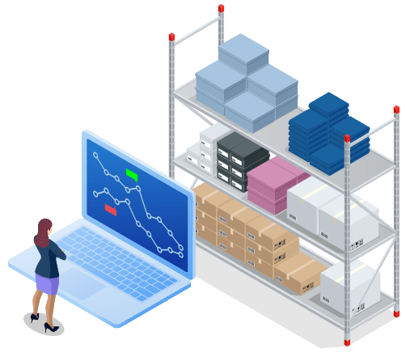

Slide 3
AGENDA
USE CASE
ABSTRACT
INTRODUCTION
EXISTING SYSTEM
PROPOSED SYSTEM
ARCHITECTURE
SOFTWARE REQUIREMENTS
HARDWARE REQUIREMENTS
SOURCE CODE
CONCLUSION
FUTURE ENHANCEMENTS

Slide 4
Use case:
In today's dynamic business landscape, the importance of effective inventory management has never been greater. Yet, many traditional inventory management systems are struggling to keep pace with the evolving demands of modern enterprises. These legacy systems often encounter common challenges such as cumbersome processes, limited access to diverse inventory options, opacity in pricing and terms, and outdated user interfaces.
Clearly, there's an urgent need for a revolutionary, customer-centric inventory management system that can usher in a new era of efficiency and convenience. Our primary objective is to revolutionize the way businesses access and control their inventory, creating a seamless and user-friendly experience that empowers organizations to thrive in today's competitive market.

Slide 5
Abstract
In a rapidly evolving business landscape, effective inventory management is paramount. However, traditional inventory systems often struggle to meet the modern demands of businesses. Challenges such as inefficient processes, limited inventory options, obscured pricing, and outdated interfaces hinder operations. There is an urgent need for an innovative, user-centric inventory management system. Our project aims to redefine how businesses access and manage their inventory, creating a seamless and convenient solution. We aspire to address these challenges and set new standards in inventory management, empowering organizations to thrive in today's competitive markets.

Slide 6
Introduction
In the era of smart technology and rapid innovation, the demand for electronic products is skyrocketing, bringing with it the need for equally advanced and efficient inventory management systems. For a company like Smart Electronics, operating in this fast-paced industry, maintaining precise control over its inventory is not just a matter of convenience but a strategic imperative. As the company continues to grow and diversify its product offerings, the challenges associated with traditional inventory management systems become increasingly evident.

Slide 7
An Inventory Management System (IMS) is crucial for businesses to efficiently track, manage, and optimize their inventory. Here, I'll describe the existing system and a proposed system for inventory management:
Existing System:
Manual System
2. Limited Visibility
3. Time-Consuming
4. Lack of Scalability:

Slide 8
PROPOSED SYSTEM
Automated Inventory Management System:
1.1 Centralized Database
1.2 Barcode/RFID Technology
2. Real-Time Tracking and Alerts
2.1 POS Integration
2.2 Alerts and Notifications

Slide 9
Proposed system
In response to the limitations of the existing inventory management system at Smart Electronics, we propose the development and implementation of a cutting-edge Inventory Management System (IMS). This proposed system aims to revolutionize how Smart Electronics manages its inventory, introducing automation, efficiency, and enhanced capabilities. Below are the key features and components of the proposed IMS:

Slide 10
Proposed system
1.Automated Tracking
2.Comprehensive Product Database:
3. Demand Forecasting and Reordering:
4.User-Friendly Interface:

Slide 11
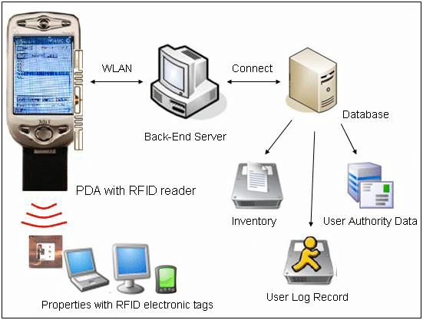
ARCHITECTURE

Slide 12
SOFTWARE REQUIREMENTS:
1.MySQL
2.Windows
3.SpringBoot
4.Eclipse
5.Tomcat
6.Postman

Slide 13
Hardware requirements
Laptop 4 GHz minimum, multi-core Processor
Memory(RAM)4GB, preferably Higher, and Commensuration with concurrent usage
Hard disk Space 1TB

Slide 14
Source code
import org.springframework.boot.SpringApplication;
import org.springframework.boot.autoconfigure.SpringBootApplication;
@SpringBootApplication
public class InventorymanagementsystemApplication {
public static void main(String[] args) {
SpringApplication.run(InventorymanagementsystemApplication.class, args);
}
}

Slide 15
com.bbproject.entity
CategoryController.java
ProductController.java
SupplierController.java

Slide 16
com.bbproject.entity
CategoryEntity.java
ProductEntity.java
SupplierEntity.java

Slide 17
com.bbproject.repository
CategoryRepository:
ProductRepository
SupplierRepository

Slide 18
com.bbproject.service
CategoryService
ProductService
SupplierService

Slide 19
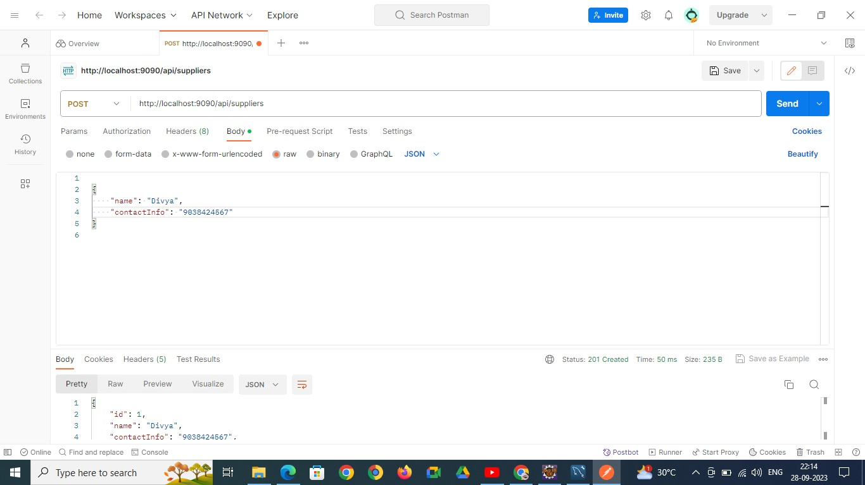
OUTPUT:
Supplier Table:
POST

Slide 20

Post

Slide 21

GET

Slide 22

PUT

Slide 23
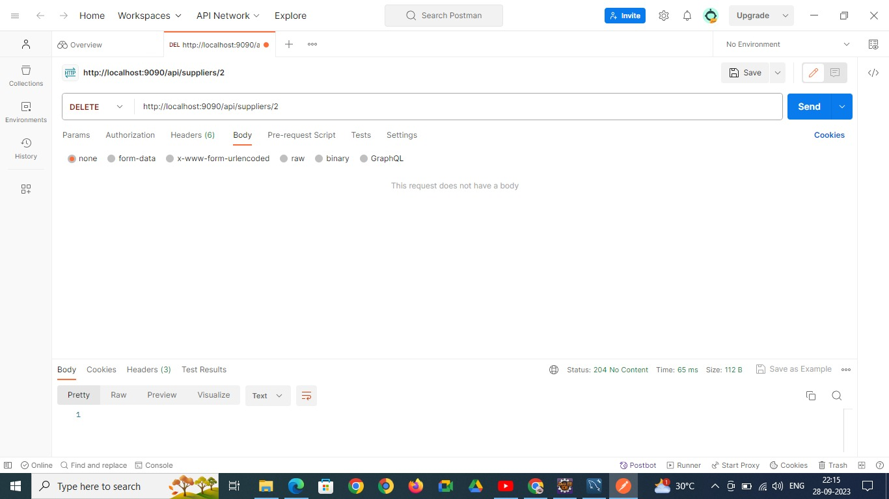
DELETE

Slide 24
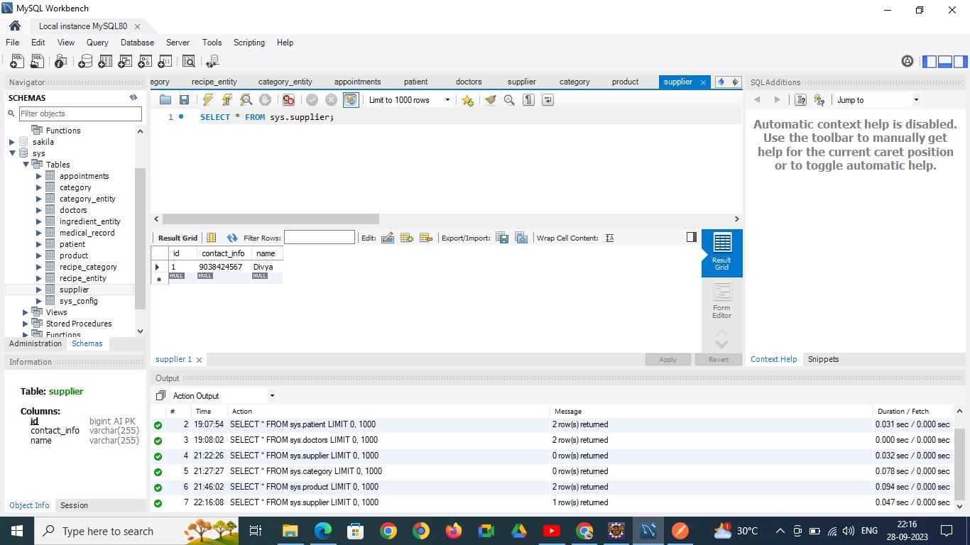

Slide 25
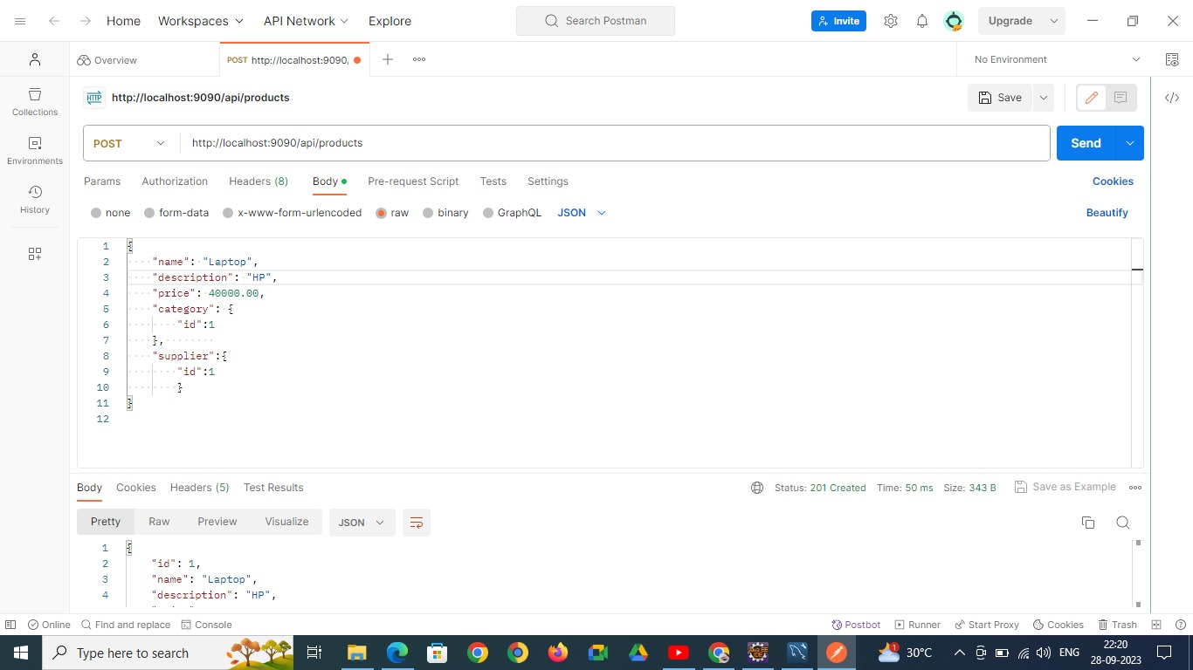
PRODUCTS TABLE:
POST

Slide 26

POST

Slide 27
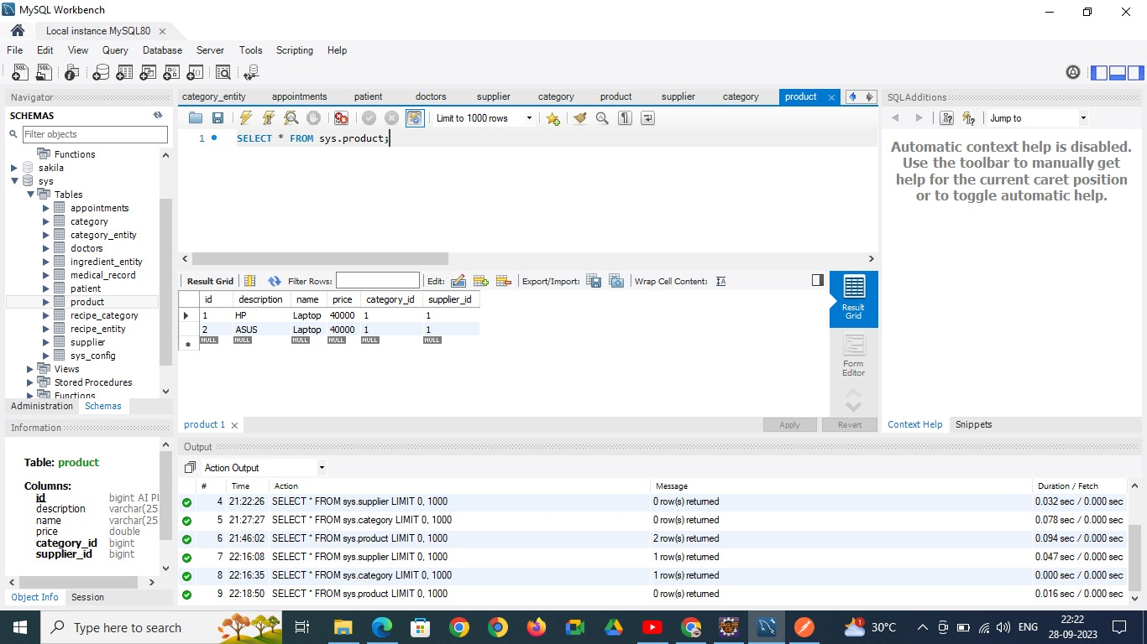

Slide 28

DELETE

Slide 29

CATEGORIES TABLE:
POST

Slide 30
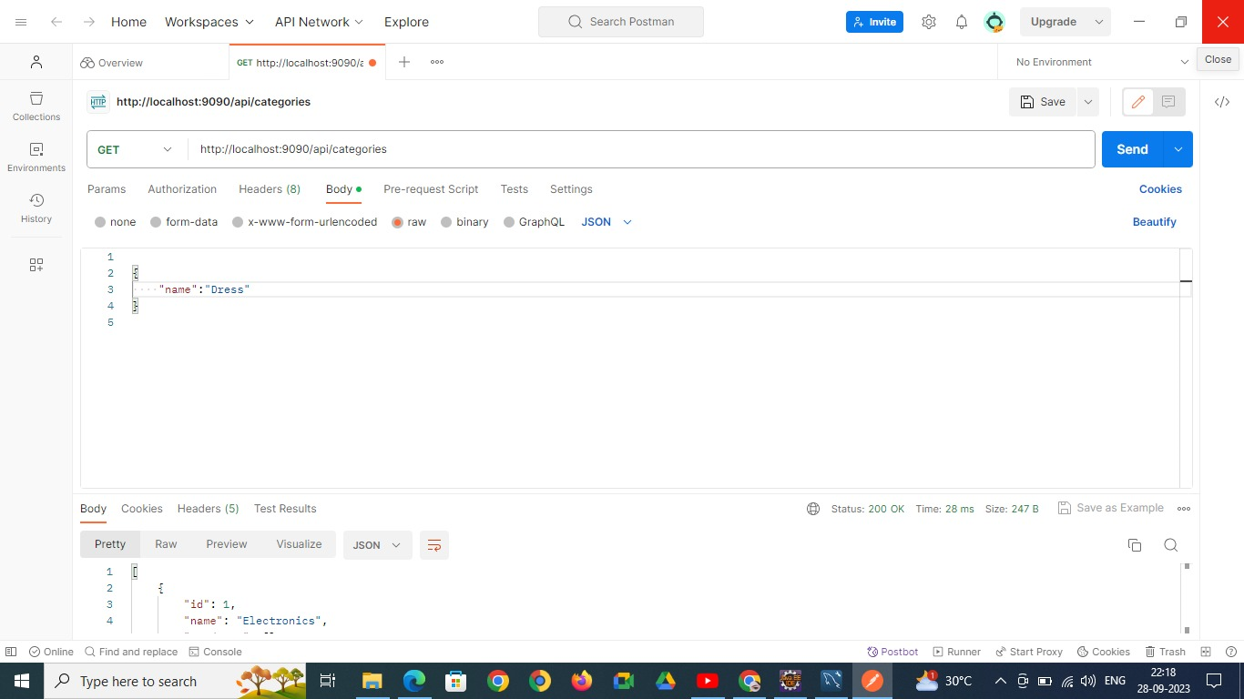
GET

Slide 31
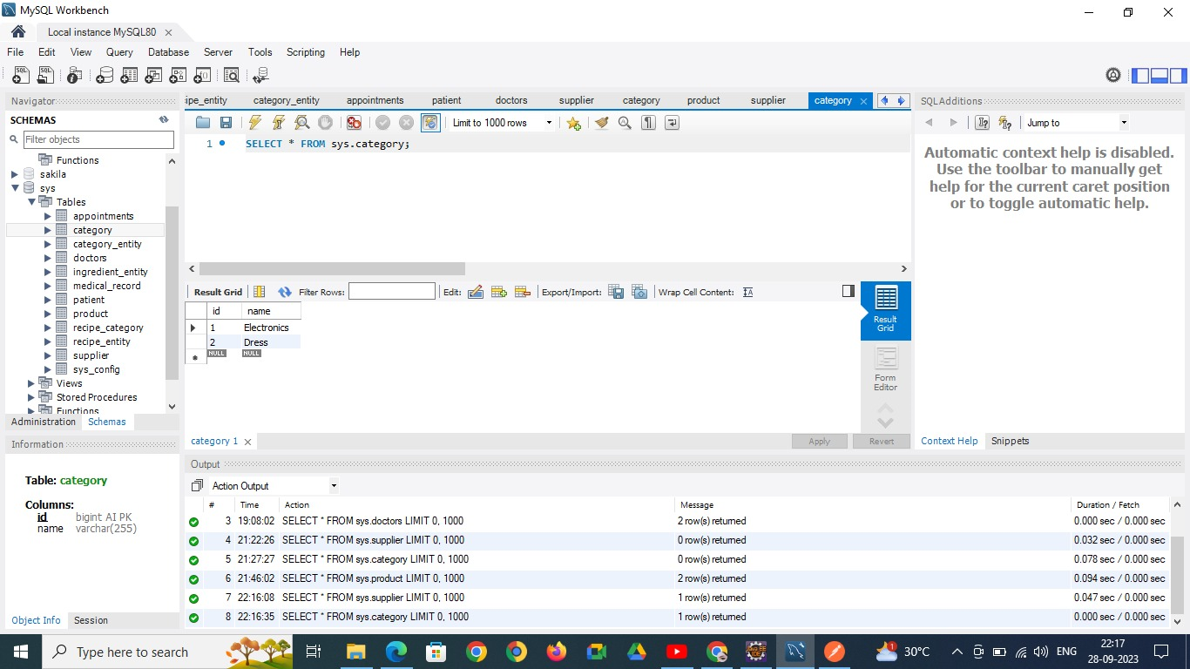

Slide 32

DELETE

Slide 33
Conclusion:
In conclusion, the Inventory Management System (IMS) project signifies a pivotal advancement in the realm of inventory control and resource management. It introduces a user-centric platform that simplifies the complexities of inventory handling, streamlining processes for efficient management while fostering collaboration and synergy among team members. By prioritizing user experience, data security, and scalability, this system equips organizations with the tools they need to optimize their inventory operations, adapt to changing demands, and enhance productivity. As we stride into the future of inventory management, the IMS stands as an adaptable and indispensable asset for businesses of all sizes, revolutionizing how we approach resource management in the digital age.

Slide 34
Future enhancements:
Looking ahead, the Inventory Management System envisions a host of exciting enhancements on the horizon. These include the implementation of advanced machine learning algorithms to offer personalized inventory management recommendations, the development of dedicated mobile applications for on-the-fly accessibility, integration of voice-activated inventory assistance, exploration of augmented reality (AR) inventory management experiences, the promotion of collaborative teamwork through challenges and events, the fortification of trust via blockchain-based inventory verification, expansion of language support for global accessibility, and the advocacy for sustainable inventory practices in alignment with environmental consciousness. These forward-looking enhancements ensure that the Inventory Management System remains at the forefront of inventory management innovation, continually engaging users and providing a dynamic and enriching inventory management experience for organizations across the spectrum.

